Slide 1
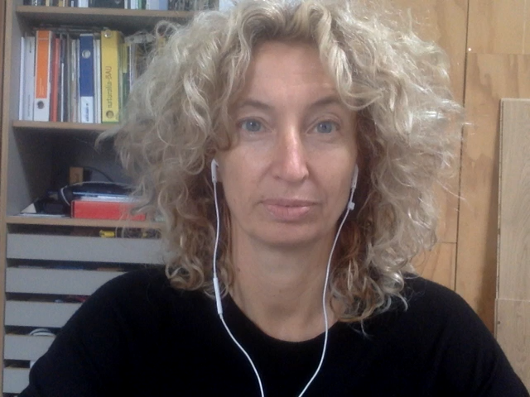
What Idea of AI?
WP4 and WP5
UNIBO, UMEA, CNR-ISTI
Start: 15/1/21
End: 15/06/21

Slide 2
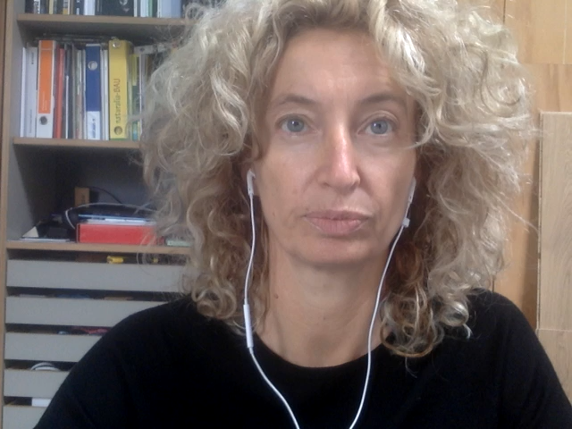
Project Aim and Idea
AIMS
to investigate the social perceptions of AI (issues of trust, bias and discrimination)
to deepen AI narratives (Hopes and Fears; Myths and Realities)
  The research explored:
  Social and public attitudes of individuals towards AI
  Factors underlining a widespread acceptance and trust of AI technology
Importance for Humane AI Net
It deepens the understandings of the social side of AI
It explores Social and public attitudes of individuals towards AI
It investigates the factors underlining a widespread acceptance of technology
More precisely:
  It highlights how to increase public acceptance of Ai based systems in everyday life (T4.3: Societal impacts)
  It deepens our understanding about the values’ wiring into socio-technical systems (T5.3: Ethics by design)

Slide 3
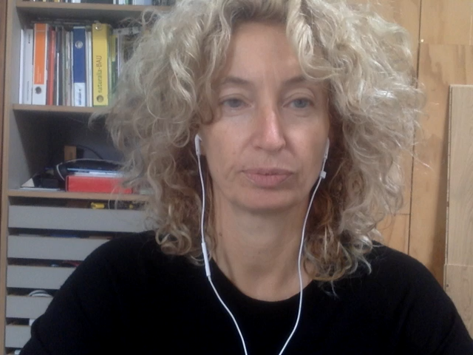
Work Performed
Design of an ad-hoc questionnaire
Online surveys set-up
  ITALY-UNIBO: administered to the whole UNIBO community; more than 6000 questionnaires collected
  SWEDEN-UMEA: administered to the UMEA community; data collection not successful (to be re-scheduled in a follow-up)
  CNR-ISTI: administered to the University of Pisa community; data collection not successful (to be re-scheduled in a follow-up)
Quantitative data analysis performed

Slide 4
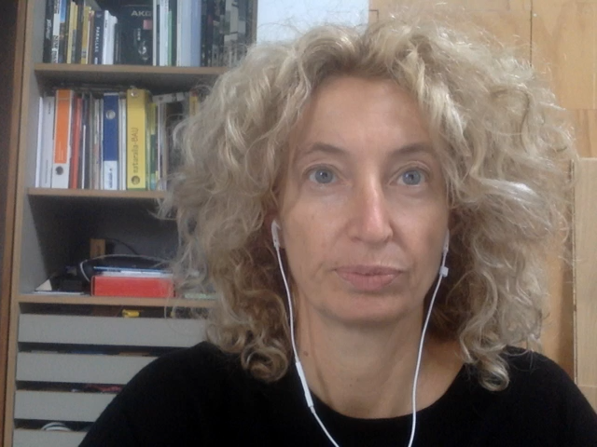
Results
Lessons learnt:
The sociodemographic profile of ordinary citizens is relevant for the levels of awareness and understanding of AI
Some traditional sources of inequality (such as gender, STEM competence and age) are relevant to AI imaginery, AI narratives of and public discourse around AI
Relevant outputs, publicly available to the community (after publication in OA)
Sartori, L. and Theodorou, A. (2021) A sociotechnical perspective for the future of AI: narratives, inequalities, and human control, Ethics and Information Technology, accepted.
Sartori, L. and Bocca, G. (2022) Minding the gap(s): public
perceptions of AI and socio-technical imaginaries, AI&Society, under review.

